Slide 1
Applied
Statistical
Analysis II
POP77004
TRINITY COLLEGE DUBLIN
OLÍVIA FREITAS
REPLICATION STUDY

Slide 2
The Cultural Origins of Populism
PAPER:
Authors: Margalit, Y., Raviv, S., & Solodoch, O. 2022
Source: Social Science Research Network. https://doi.org/10.2139/ssrn.4001543

Slide 3
WHAT IS THE PAPER ABOUT?
The paper explores why populism emerges.
Specifically, it looks at how cultural factors influence people’s voting behavior
Where?
Switzerland, Germany, Denmark, France, United Kingdom, Hungary, Italy, Netherlands, Poland, and Sweden

Slide 4
Hypotheses
The authors propose several hypotheses related to the cultural origins of populism:
01
Ethno-Cultural Change: Concerns about ethno-cultural change induced by immigration play a central role in understanding the populist vote.
02
Rural Resentment: Rural resentment contributes to populist voting behavior, although to a lesser extent.
03
Status Anxiety: Feelings of status anxiety also influence populist choices.
04
Other Storylines: Explanations centered on communal disintegration or an intergenerational values divide are pertinent in specific cases.

Slide 5
Research Questions
01
02
03
Group Size
How sizable is the group to which each storyline pertains?
How well does the grievance associated with each storyline distinguish right-wing populist voters from voters of other parties?
Distinctiveness
Consistency Across Countries
What extent are the findings consistent across different countries?

Slide 6
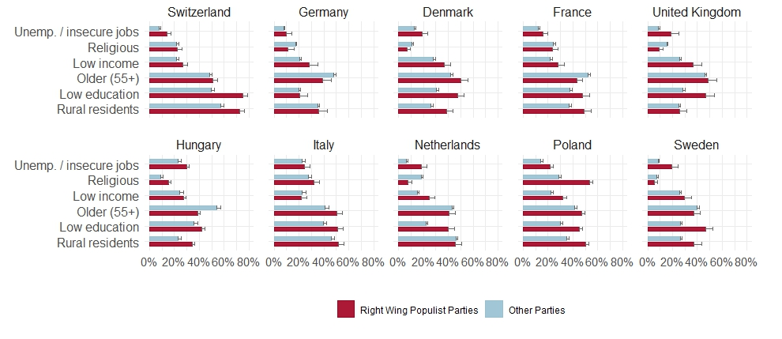
THE ORIGINAL STUDY

Slide 7
KEY INSIGHTS
Ethno-Cultural Change
Rural Resentment and Status Anxiety
Other Storylines
Concerns about cultural change due to immigration play a central role in understanding the populist vote.
These factors also contribute, but to a lesser extent.
Some cultural explanations (like communal disintegration or intergenerational values) matter only in specific cases.

Slide 8
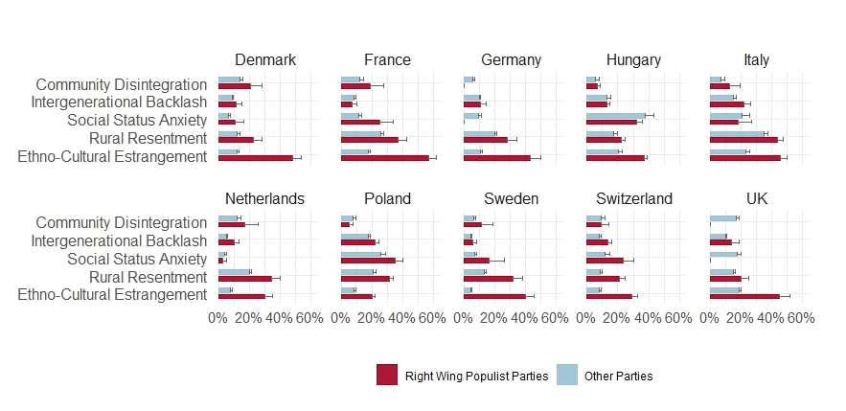
THE ORIGINAL STUDY

Slide 9
KEY INSIGHTS
Community Disintegration
Intergenerational Backlash
Social Status Anxiety
Rural Resentment
Ethno-Cultural Estrangement
Rural Resentment
This factor seems to have varying influence across countries.
This factor appears to have a minor influence on voting behavior.
This factor seems to have a moderate influence on voting behavior.
This factor appears to have a significant influence in some countries.
This factor appears to have a significant influence in some countries.

Slide 10
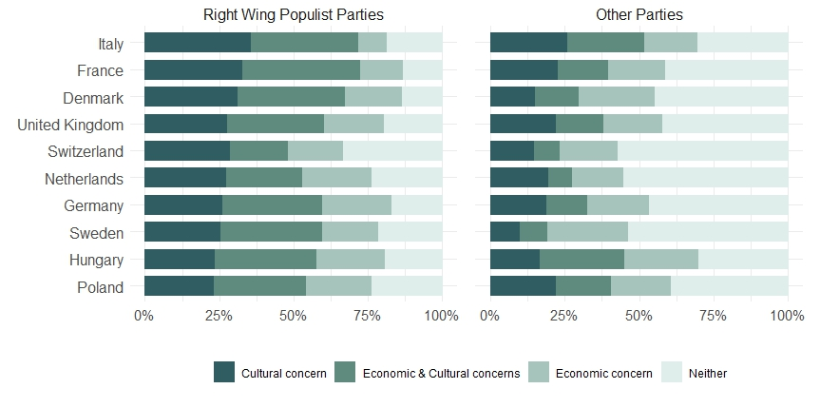
THE ORIGINAL STUDY

Slide 11
KEY INSIGHTS
Cultural Concern
Economic & Cultural Concerns
Economic Concern
Neither
Rural Resentment
In some countries, a significant portion of the vote share for right-wing populist parties is driven by cultural concerns.
In other countries, both economic and cultural concerns contribute to the vote share for right-wing populist parties.
In yet other countries, economic concerns play a major role in driving the vote share for right-wing populist parties.
In some cases, neither economic nor cultural concerns seem to significantly influence the vote share for right-wing populist parties.

Slide 12
REPLICATION
Investigating Interaction Effects

Slide 13
THE RATIONALE BEHIND INVESTIGATING
INTERACTION EFFECTS
We can understand whether the relationship between two variables changes based on their combined influence.
We focused on the interaction between “economic insecurity” and “cultural concern” in shaping voting behavior.
Interaction effects can reveal nuances that individual main effects might miss, providing a richer understanding of the data.

Slide 14
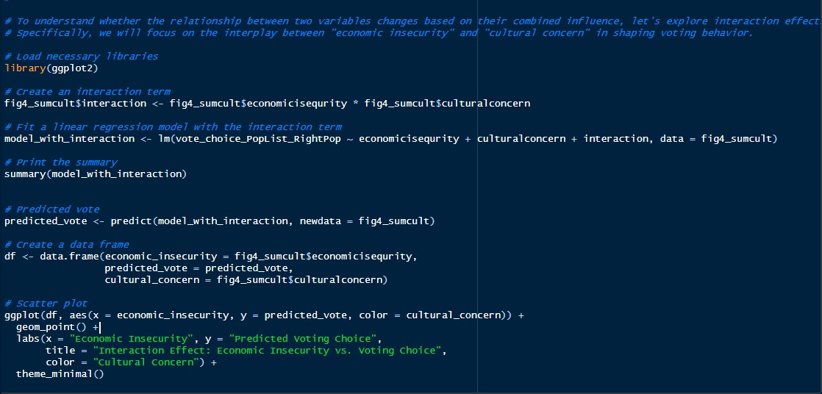
R

Slide 15
OUR ANALYSIS
Interaction Term
We created an “interaction term” by multiplying the values of economic insecurity and cultural concern. This term captures the joint effect of both factors.
Linear Regression Model
We build a model that predicts voting choices based on economic insecurity, cultural concern, and their interaction.
The model estimates how changes in these factors impact the predicted vote.
Model Summary
We summarised the model using the summary() function.
It shows coefficients (effects) for each factor and the interaction term.
We checked if the interaction term is statistically significant (low p-value).
Predicted Vote
We calculated the predicted vote using the model.
This tells us what voting choice the model expects based on the input factors.
Scatter Plot
We created a scatter plot to visualise the relationship.

Slide 16
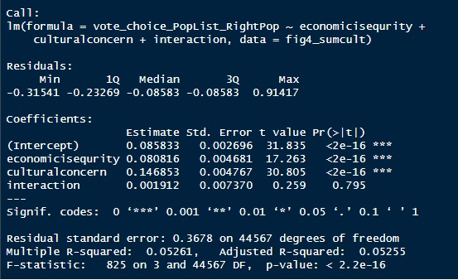
RESULTS

Slide 17
RESULTS
Coefficients:
Intercept (Constant): The estimated intercept (constant) is approximately 0.0858. This represents the predicted voting choice when both economicisequrity and culturalconcern are zero.
Economic Insecurity (economicisequrity): For each unit increase in economic insecurity, the predicted voting choice increases by approximately 0.0808 (holding other variables constant).
Cultural Concern (culturalconcern): For each unit increase in cultural concern, the predicted voting choice increases by approximately 0.1469 (holding other variables constant).
Interaction Term: The interaction term (interaction) does not appear to be statistically significant. Its coefficient is approximately 0.0019, and the p-value is 0.795 (greater than the common significance level of 0.05).

Slide 18
RESULTS
Residuals:
The residuals represent the differences between the actual observed values and the predicted values. They have a range from approximately -0.3154 to 0.9142.
The median residual is -0.0858, indicating that, on average, the model tends to slightly overestimate the voting choice.
Model Fit:
The multiple R-squared value is 0.0526, which means that approximately 5.26% of the variability in the voting choice can be explained by the model.
The adjusted R-squared value is similar, indicating that the model’s explanatory power is limited.
The F-statistic tests the overall significance of the model, and the extremely low p-value (< 2.2e-16) suggests that the model is statistically significant.

Slide 19
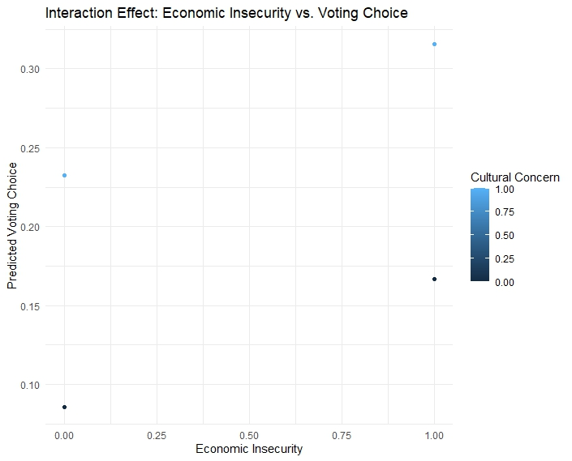
Interaction Effects
BACKGROUND
We studied how “economic insecurity” and “cultural concern” influence voting behavior.
We created a model to predict voting choices based on these factors.
FINDINGS
Economic Insecurity: When economic insecurity increases, people tend to vote differently.
Cultural Concern: People’s cultural concerns also impact their voting choices.

Slide 20
Interaction Effects
We explored whether the combination of economic insecurity and cultural concern has a unique effect.
Surprisingly, the interaction term didn’t significantly affect voting behavior.
Model Strength:
Our model explains about 5% of the variability in voting choices.
While statistically significant, other factors may play a role too.
Further investigation or additional variables might improve the model’s explanatory power.

Slide 21
Overall, while individual factors matter (economic insecurity and cultural concern), their combined effect does not substantially alter voting behavior in this context.

Slide 22
THANKS!

